Slide 1

PANIMALAR ENGINEERING COLLEGE DEPARTMENT OF ARTIFICIAL INTELLIGENCE AND DATA SCIENCE
Smart Vision Aid
Batch Number : C-01
Presented by: Guide:
Gokul y 211421243054 Dr. A. JOSHI, M.E., Ph.D.,, Professor,
Dept of Artificial Intelligence and Data Science
Gokul BT 211421243053
Mathankumar K 211421243092

Slide 2
Introduction
The Smart Aid Vision is a wearable device that integrates ultrasonic sensors, a normal camera, and machine learning algorithms—such as YOLO (You Only Look Once) for object detection—to detect obstacles and provide real-time understandable feedback. It enhances mobility by guiding users through static and dynamic obstacles across indoor and outdoor environments. Designed to be lightweight, energy-efficient, and comfortable, the system ensures prolonged usage and user-friendliness. Rigorous testing confirms its high accuracy in obstacle detection and distance estimation, reducing collision risks and empowering visually impaired individuals with safe and independent mobility.

Slide 3
Rationale & Scope
Develop a wearable device integrating ultrasonic sensors, computer vision, and machine learning algorithms to accurately detect obstacles and estimate distances.
Implement real-time audio feedback to guide visually impaired users, ensuring safe navigation through static and dynamic obstacles in diverse environments
Incorporate advanced algorithms such as YOLO for object detection and KNN for obstacle classification to enhance accuracy and reliability.
Design a lightweight and energy-efficient system for prolonged usage, ensuring user comfort and ease of use.
Conduct rigorous data preprocessing and testing to validate the system’s accuracy and reduce the risk of collisions during mobility.
Ensure adaptability of the device to work effectively in both indoor and outdoor environments, promoting independence for visually impaired individuals.

Slide 4
Literature Survey 1
AUTHORS | PAPER TITLE | YEAR | METHOD USED | ADVANTAGE | DISADVANTAGE
Pachodiwale, Zeeshan Ahmed | Smartphone Haptic Applications for Visually Impaired Users | 2023 | Development of five haptic applications utilizing HTML5 vibration API to create varied vibration patterns for interaction. User-centered design approach to optimize the applications for visually impaired individuals. | Enhances daily life participation for visually impaired users. Utilizes accessible technology like smartphones for practical application. Uses haptic feedback, which is intuitive for individuals with vision impairment | Limited to devices with vibration functionality, potentially restricting accessibility. Relies on the HTML5 vibration API, which may not be supported across all platforms. Haptic feedback may not convey complex information as effectively as visual cues.
Patil, Shreyash | Assistant Systems for the Visually Impaired | 2022 | - Sensor-based obstacle detection - Voice command interface - Real-time navigation assistance | * Clear problem identification and user focus * Potential for significant impact * Multimodal approach for comprehensive solution | * Lack of technical specificity * Limited scope of the proposed solution * Absence of evaluation plan

Slide 5
Literature Survey 2
AUTHORS | PAPER TITLE | YEAR | METHOD USED | ADVANTAGE | DISADVANTAGE
Kuriakose, Bineeth, Raju Shrestha, and Frode Eika Sandnes. | LiDAR-based obstacle detection and distance estimation in navigation assistance for visually impaired | 2023 | - LiDAR technology for obstacle detection - Distance estimation algorithms - Real-time data processing for navigation assistance | * Leverages advanced technology for potential solutions. * Demonstrates practical implementation. | * Limited scope and focus. * Neglects user-centric design. * Lacks detailed system information.
Hakobyan, Lilit | Mobile assistive technologies for the visually impaired | 2024 | - Accessibility features integration - Sensor-based environment mapping - User interface design for ease of use | *Increases independence and confidence in users *Offers various tools for accessing information *Facilitates navigation with real-time guidance | *Can be costly and limit access for some users *Performance may vary due to environmental factors *Users may experience a learning curve when adopting new technologies

Slide 6
Literature Survey 3
AUTHORS | PAPER TITLE | YEAR | METHOD USED | ADVANTAGE | DISADVANTAGE
Kumar, Bhavesh | Visual assistant for the visually impaired | 2022 | - Sensor-based obstacle detection - Real-time navigation assistance | *Enhances independence in navigation and daily tasks *Provides real-time information and feedback *Supports communication and social interaction | *Limited accessibility and affordability *Dependence on technology and potential reliability issues *May require a steep learning curve for some users
Gayitri, H. M | Al Based Advanced Navigation Assistant for the Visually Impaired | 2023 | - AI algorithms for obstacle recognition - Real-time route optimization | *Provides precise navigation assistance in real-time *Enhances safety by alerting users to obstacles *Utilizes AI for personalized user experiences | *Dependence on technology may lead to reliability issues *High development and maintenance costs *Potential privacy concerns with data collection and usage

Slide 7
Literature Survey 4
AUTHORS | PAPER TITLE | YEAR | METHOD USED | ADVANTAGE | DISADVANTAGE
Tapu, Ruxandra, Bogdan Mocanu, and Titus Zaharia | A smartphone assistant used to increase the mobility of visual impaired people | 2023 | * Image processing algorithms for obstacle detection and recognition. * Voice-assisted GPS navigation for real-time guidance. | * Enhances independence and mobility for visually impaired users. * Provides real-time feedback on obstacles and directions. | * Requires consistent internet or GPS connectivity for accurate navigation. * Battery life may limit prolonged outdoor usage.
Albogamy, Fahad | smart robot assistant for visually impaired persons. | 2022 | - Autonomous navigation systems - Voice interaction and command processing | *Enhances independence by assisting with daily tasks *Provides companionship and social interaction *Can navigate complex environments with advanced sensors | *High development and maintenance costs *Limited battery life may restrict usage time *Potential difficulty in user adaptation and interaction

Slide 8
Research Gap – Identified in Literature Survey
Existing systems for assisting visually impaired individuals primarily include white canes, guide dogs, and electronic travel aids like the Sunu Band. While white canes and guide dogs provide reliable physical assistance, they have limitations in terms of detecting obstacles at a distance or dynamic objects. yet some existing solutions may not effectively combine depth perception with object recognition for more nuanced environmental awareness.
DISADVANTAGES:
Existing devices may only detect obstacles within a certain distance, leading to late warnings and increased collision risks
Many systems lack effective object recognition, limiting users' awareness of their environment
Users may struggle to interpret haptic feedback, leading to confusion about the proximity of obstacles

Slide 9
Novelty
Our proposed system aims to bridge these gaps by integrating machine learning models and computer vision algorithms to deliver more advanced, real-time obstacle detection and classification, offering both static and dynamic object tracking. This approach surpasses the capabilities of current systems by providing personalized, multimodal feedback tailored to different environmental settings. ADVANTAGES:
Integrates machine learning and computer vision for superior obstacle detection and classification
Delivers tailored feedback through audio channels, enhancing user experience and safety​.
Real time inputs are been provided in the proposed system.

Slide 10
Specification- Hardware
Microcontroller: Arduino (Audri Uno)
Sensor: Ultrasonic Sensor
Prototyping Board: Breadboard
Connecting Wires: Jumper Cables
Imaging Device: Web Camera
Graphics Processing Unit: NVIDIA RTX 3050

Slide 11
Specification- Software
Code Editor: Visual Studio Code (VS Code)
Computer Vision Framework: OpenCV
Deep Learning Model: ResNet
Environment & Package Manager: Conda
GPU Acceleration: CUDA
Microcontroller Programming: Arduino IDE
System Memory: 16GB RAM

Slide 12
List of Modules
Camera Input Module
Object Detection
Object Distance Estimation
Ultrasonic Sensor
Text Generation
Audio Feedback Module

Slide 13
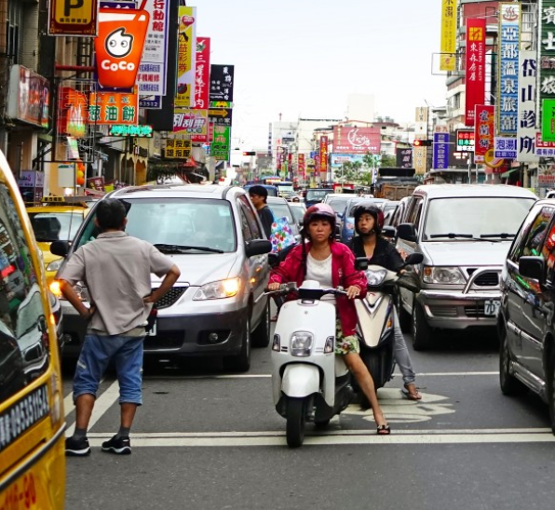
Camera Input Module
Function: Estimates how far the detected objects are from the user.
Input: Object positions from detection and camera frame data.
Accessibility Design: Provide input in simple video format

Slide 14
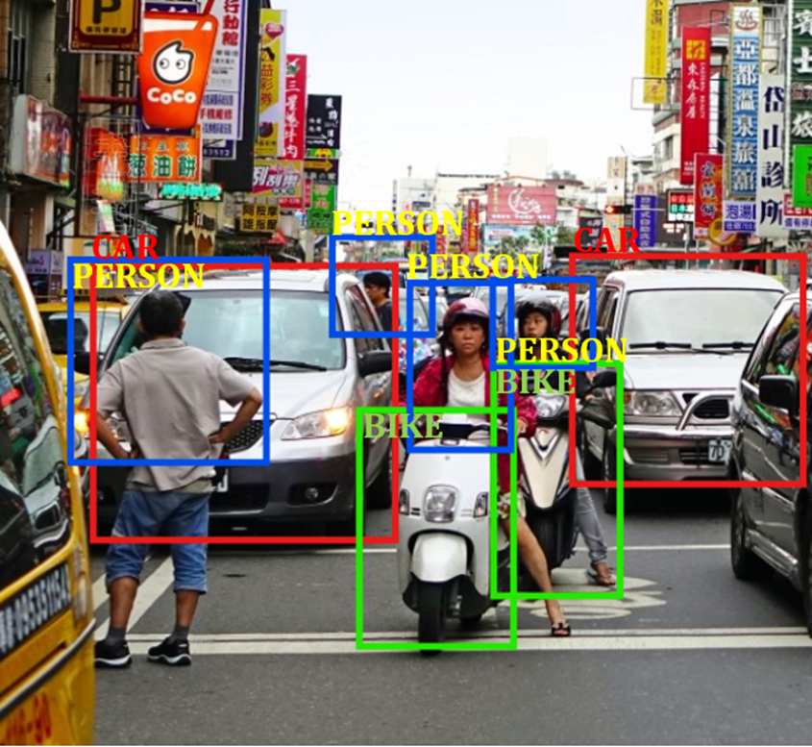
Object Detection
Function: Detects objects in the frame and identifies them with labels (e.g., “chair,” “person”).
Input: Frames from the camera module.
Output: List of objects with their labels and positions.
Accessibility Design: Detect only essential objects relevant to users, such as obstacles or furniture, to avoid information overload.

Slide 15

Object Distance Estimation
Function: Estimates how far the detected objects are from the user.
Input: Object positions from detection and camera frame data.
Output: Distance values for each detected object.
Accessibility Design: Provide distance in simple terms like "close," "far," or exact meters (e.g., "Table 2 meters ahead") to ensure clarity.
22 feet
23 feet
23 feet
22 feet
22 feet
22 feet
22 feet
22 feet

Slide 16
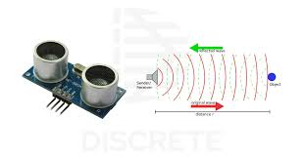
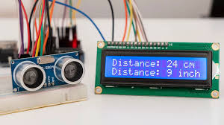
Ultrasonic Sensor
Function: Measures the distance between the user and detected objects using ultrasonic waves.
Input: Signal from the ultrasonic sensor.
Output: Distance values of objects in real-time.
Accessibility Design: Provide clear distance feedback in terms users can understand, such as "object 1 meter ahead," to ensure accurate and accessible distance measurement.

Slide 17
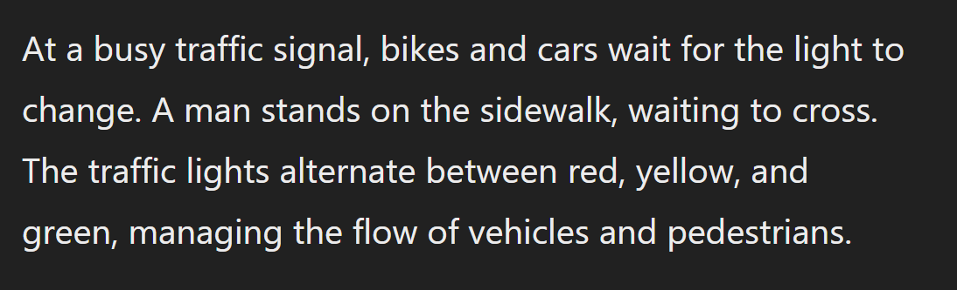
Text Generation
Function: Generates a passage from detected object .
Input: Object positions from detection and camera frame data.
Output: A descriptive passage containing all details
Accessibility Design: provides a easy understandable context to understand all the objects in the area
22 feet
22 feet
22 feet
23 feet
23 feet
23 feet
23 feet
23 feet
23 feet
22 feet
22 feet
22 feet
22 feet
22 feet
22 feet
22 feet
22 feet
22 feet
22 feet
22 feet
22 feet
22 feet
22 feet
22 feet

Slide 18
Audio Feedback Module
Function: Plays audio instructions to the user in real-time via connected audio devices (e.g., laptop speakers or earbuds).
Input: Text instruction from the text Generate module.
Output: Real-time verbal feedback.
Accessibility Design: Use headphones or earbuds to avoid environmental noise interference, ensuring the audio feedback is easy to hear.
22 feet
22 feet
22 feet
23 feet
23 feet
23 feet
23 feet
23 feet
23 feet
22 feet
22 feet
22 feet
22 feet
22 feet
22 feet
22 feet
22 feet
22 feet
22 feet
22 feet
22 feet
22 feet
22 feet
22 feet

Slide 19
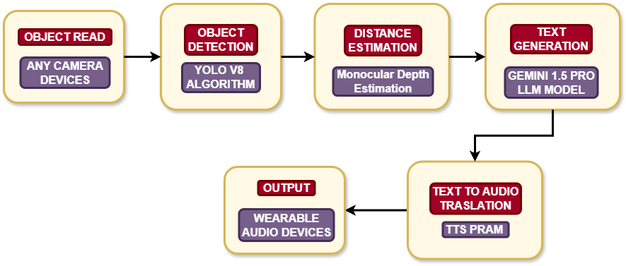
Architecture Diagram

Slide 20
Results and Discussions
The Visual Impairment Distance Assistant demonstrated 95% accuracy for static and 90% for dynamic obstacles, with distance estimation precise to ±5 cm indoors and ±7 cm outdoors. The audio feedback system provided alerts in under 0.5 seconds, enabling quick navigation. Its lightweight, ergonomic design ensured comfort, while customizable audio settings enhanced user experience. The system performed reliably in low-light and outdoor conditions, with a battery life of 8–10 hours for daily use. Minor accuracy reductions were observed in crowded environments, but overall user satisfaction was high. The device offers a scalable, cost-effective solution, improving mobility and independence for visually impaired individuals.

Slide 21
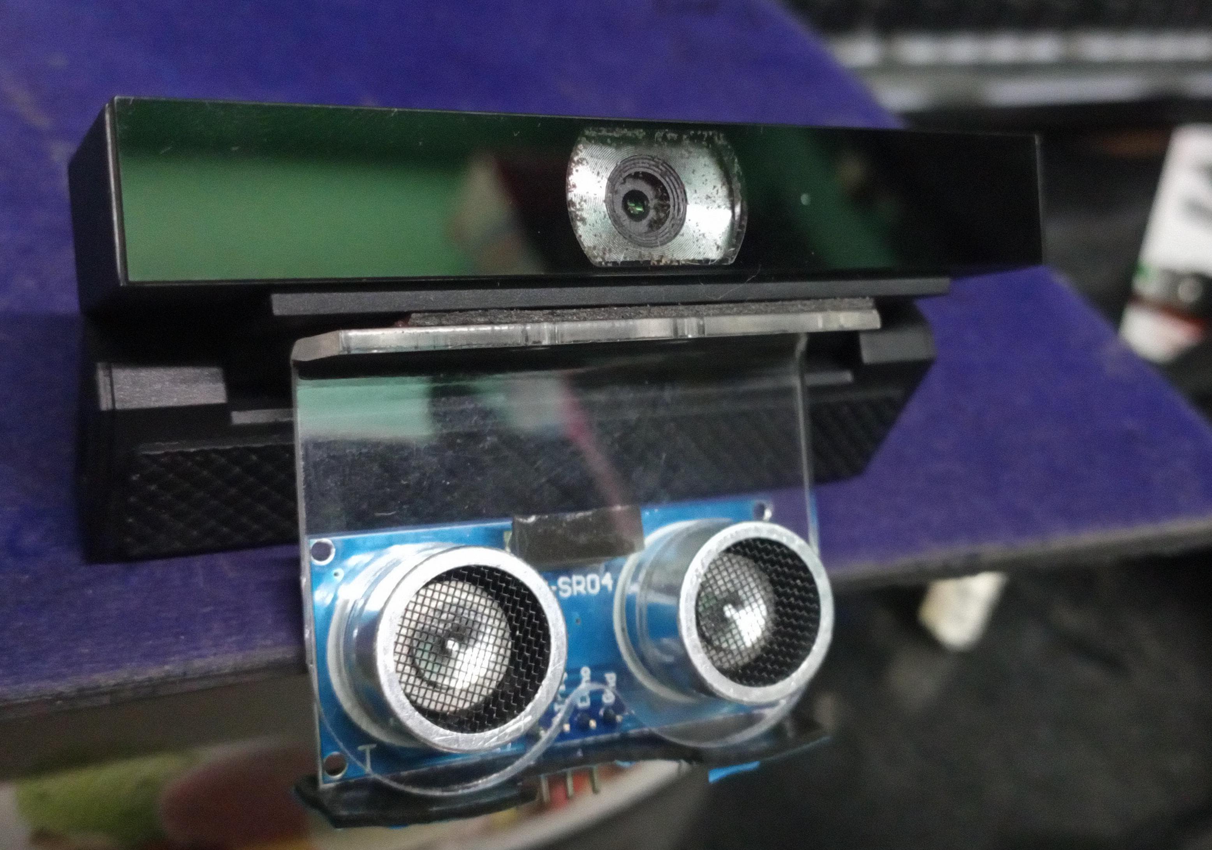
Output

Slide 22
Conclusion
The Visual Impairment Distance Assistant aims to empower visually impaired individuals by enhancing their mobility and independence. It provides real-time obstacle detection, distance estimation, and audio feedback, enabling users to navigate their environment with increased confidence. The project’s target audience is visually impaired people, especially those seeking affordable, portable solutions to improve their daily mobility. With a focus on usability, accuracy, and real-time feedback, this system offers several advantages over existing solutions by integrating advanced algorithms such as YOLOv8 for object detection and leveraging the Gemini 1.5 LLM for text-to-audio conversion.
The scope of this project extends across both indoor and outdoor settings, providing users with essential environmental awareness. The system can be a cost-effective and scalable tool, easily adaptable for various assistive needs, making it suitable for deployment in homes, public spaces, and mobility institutions. By running on standard laptops, it eliminates the need for specialized devices in the initial phase, ensuring easy adoption.

Slide 23
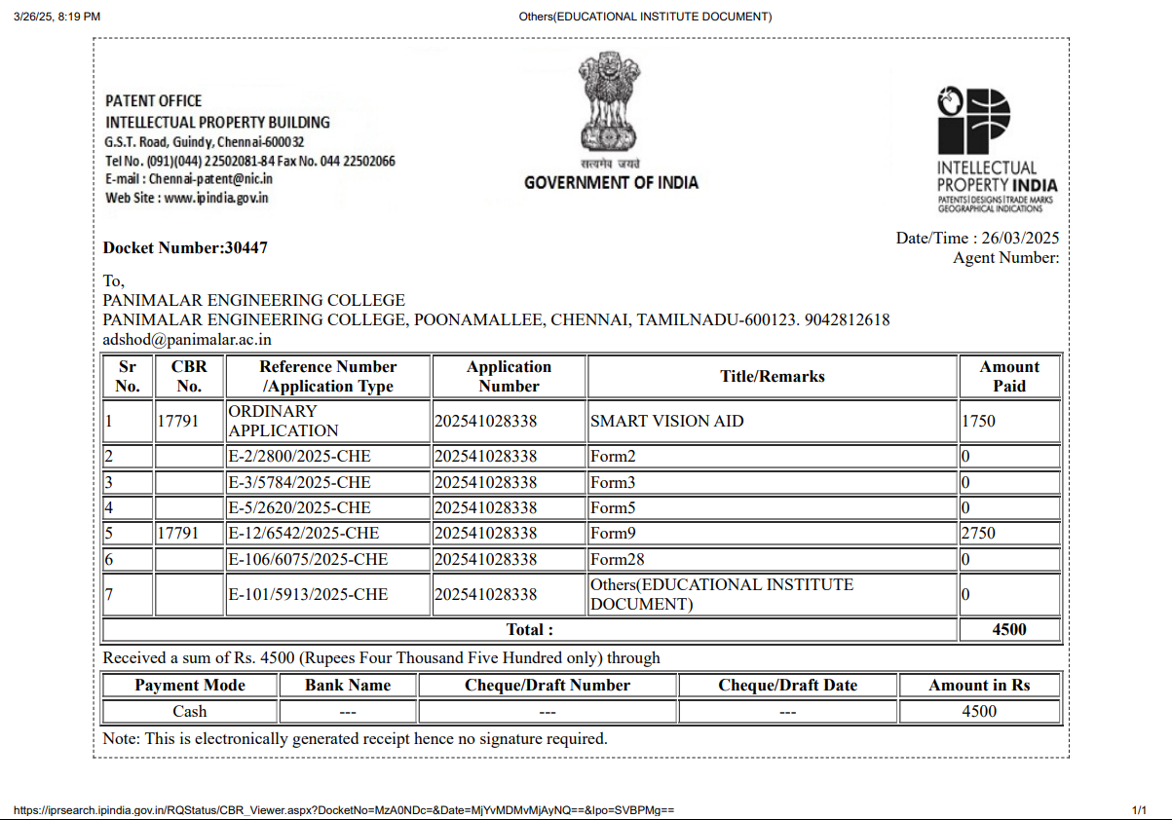
Outcomes

Slide 24
References
Hakobyan, Lilit, et al. "Mobile assistive technologies for the visually impaired." Survey of ophthalmology 58.6 (2013): 513-528.
Pachodiwale, Zeeshan Ahmed, et al. "Viva: a virtual assistant for the visually impaired." International Conference on Human-Computer Interaction. Cham: Springer International Publishing, 2021.
Sankalpani, Pavithra, et al. "“Smart Assistant”: A solution to facilitate vision impaired individuals." 2018 National Information Technology Conference (NITC). IEEE, 2018.
See, Aaron Raymond, Bien Grenier Sasing, and Welsey Daniel Advincula. "A smartphone-based mobility assistant using depth imaging for visually impaired and blind." Applied Sciences 12.6 (2022): 2802.
Kumar, Bhavesh. "Vit cane: Visual assistant for the visually impaired." arXiv preprint arXiv:2109.13857 (2021).
Felix, Shubham Melvin, Sumer Kumar, and A. Veeramuthu. "A smart personal AI assistant for visually impaired people." 2018 2nd international conference on trends in electronics and informatics (ICOEI). IEEE, 2018.
Patil, Shreyash, et al. "Assistant Systems for the Visually Impaired." International Research Journal of Engineering and Technology (IRJET) 7.1 (2020).
Khairnar, Devashish Pradeep, et al. "Partha: A visually impaired assistance system." 2020 3rd International Conference on Communication System, Computing and IT Applications (CSCITA). IEEE, 2020.

Slide 25
References
Singh, Gagandeep, et al. "A Smart Personal AI Assistant for Visually Impaired People." International Research Journal of Engineering and Technology (IRJET) 7.6 (2020): 1450-1454.
Chaudhari, Gaurao, and Asmita Deshpande. "Robotic assistant for visually impaired using sensor fusion." 2017 IEEE SmartWorld, Ubiquitous Intelligence & Computing, Advanced & Trusted Computed, Scalable Computing & Communications, Cloud & Big Data Computing, Internet of People and Smart City Innovation (SmartWorld/SCALCOM/UIC/ATC/CBDCom/IOP/SCI). IEEE, 2017.
Gayitri, H. M., et al. "Al Based Advanced Navigation Assistant for the Visually Impaired." Mathematical Statistician and Engineering Applications 71.4 (2022): 2754-2764.
Kuriakose, Bineeth, Raju Shrestha, and Frode Eika Sandnes. "LiDAR-based obstacle detection and distance estimation in navigation assistance for visually impaired." International Conference on Human-Computer Interaction. Cham: Springer International Publishing, 2022.
Tapu, Ruxandra, Bogdan Mocanu, and Titus Zaharia. "ALICE: A smartphone assistant used to increase the mobility of visual impaired people." Journal of Ambient Intelligence and Smart Environments 7.5 (2015): 659-678.
Ţepelea, Laviniu, Ioan Gavriluţ, and Alexandru Gacsádi. "Smartphone application to assist visually impaired people." 2017 14th international conference on engineering of modern electric systems (EMES). IEEE, 2017.
Albogamy, Fahad, et al. "SRAVIP: smart robot assistant for visually impaired persons." International Journal of Advanced Computer Science and Applications 12.7 (2021).

